Slide 1


Medassist AI: Empowering Primary Care Providers
Medassist AI is an AI-driven assistant for nurses, community health workers, and general practitioners. It improves frontline diagnosis and treatment. This innovative tool reduces the burden on specialist physicians.
by Jerim Owino

Slide 2

The Challenge: Overburdened Healthcare Systems
Specialist Shortages
Complex General Cases
Many regions face severe shortages of specialist doctors. This creates significant delays in patient care.
General practitioners often manage broad, complex cases. They need more support for diverse conditions.
Diagnostic Errors
Fatigue, data overload, or limited specialist support can lead to diagnostic errors.

Slide 3
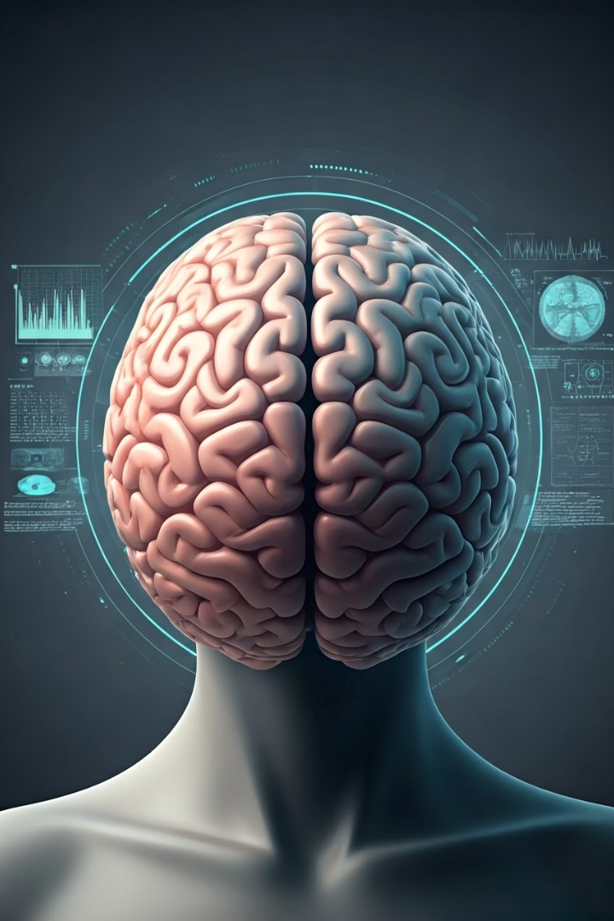




How Medassist AI Works
Analyzes Patient Data
Uses advanced machine learning and natural language processing.
Synthesizes Information
Combines medical records, symptoms, images, and guidelines.
Delivers Recommendations
Provides evidence-based diagnoses and treatment suggestions.
Suggests Referrals
Offers accurate referral recommendations to specialists.

Slide 4





Key Features of Medassist AI
Symptom Checker
Maps patient symptoms to thousands of known medical conditions.
Treatment Recommendations
Suggests evidence-based treatments tailored to patient history.
Specialist Flags
Identifies cases needing specialist attention or urgent referral.
Workflow Integration
Integrates into clinical workflows for real-time decision support.

Slide 5
Benefits for Clinicians and Patients
For Clinicians
For Patients
Reduces diagnostic errors.
Faster, more accurate diagnoses.
Standardizes care with unbiased analysis.
Consistent, high-quality care.
Saves time on complex records.
Improved health outcomes.

Slide 6

Real-World Impact and Evidence
95%+
30%
Accuracy
Faster Diagnosis
AI diagnostic tools match or surpass human experts in accuracy.
Studies show significantly faster diagnosis times with AI support.
15%
Cost Reduction
Lower healthcare costs by optimizing specialist referrals.

Slide 7






Ensuring Quality, Safety, and Trust
Ethical Safeguards
Ensures patient data privacy and bias mitigation in algorithms.
Diverse Data Training
System trained on vast, up-to-date datasets for reliability.
Augments Expertise
Designed to augment, not replace, clinical expertise and judgment.

Slide 8

Looking Forward: Building Smarter Healthcare Together
Redefine Healthcare
Potential to transform frontline healthcare delivery globally.
Expand Features
Developing new features for more specialties and complex conditions.
Pilot Program
Invitation to pilot Medassist AI and shape the future of care.

